Slide 1
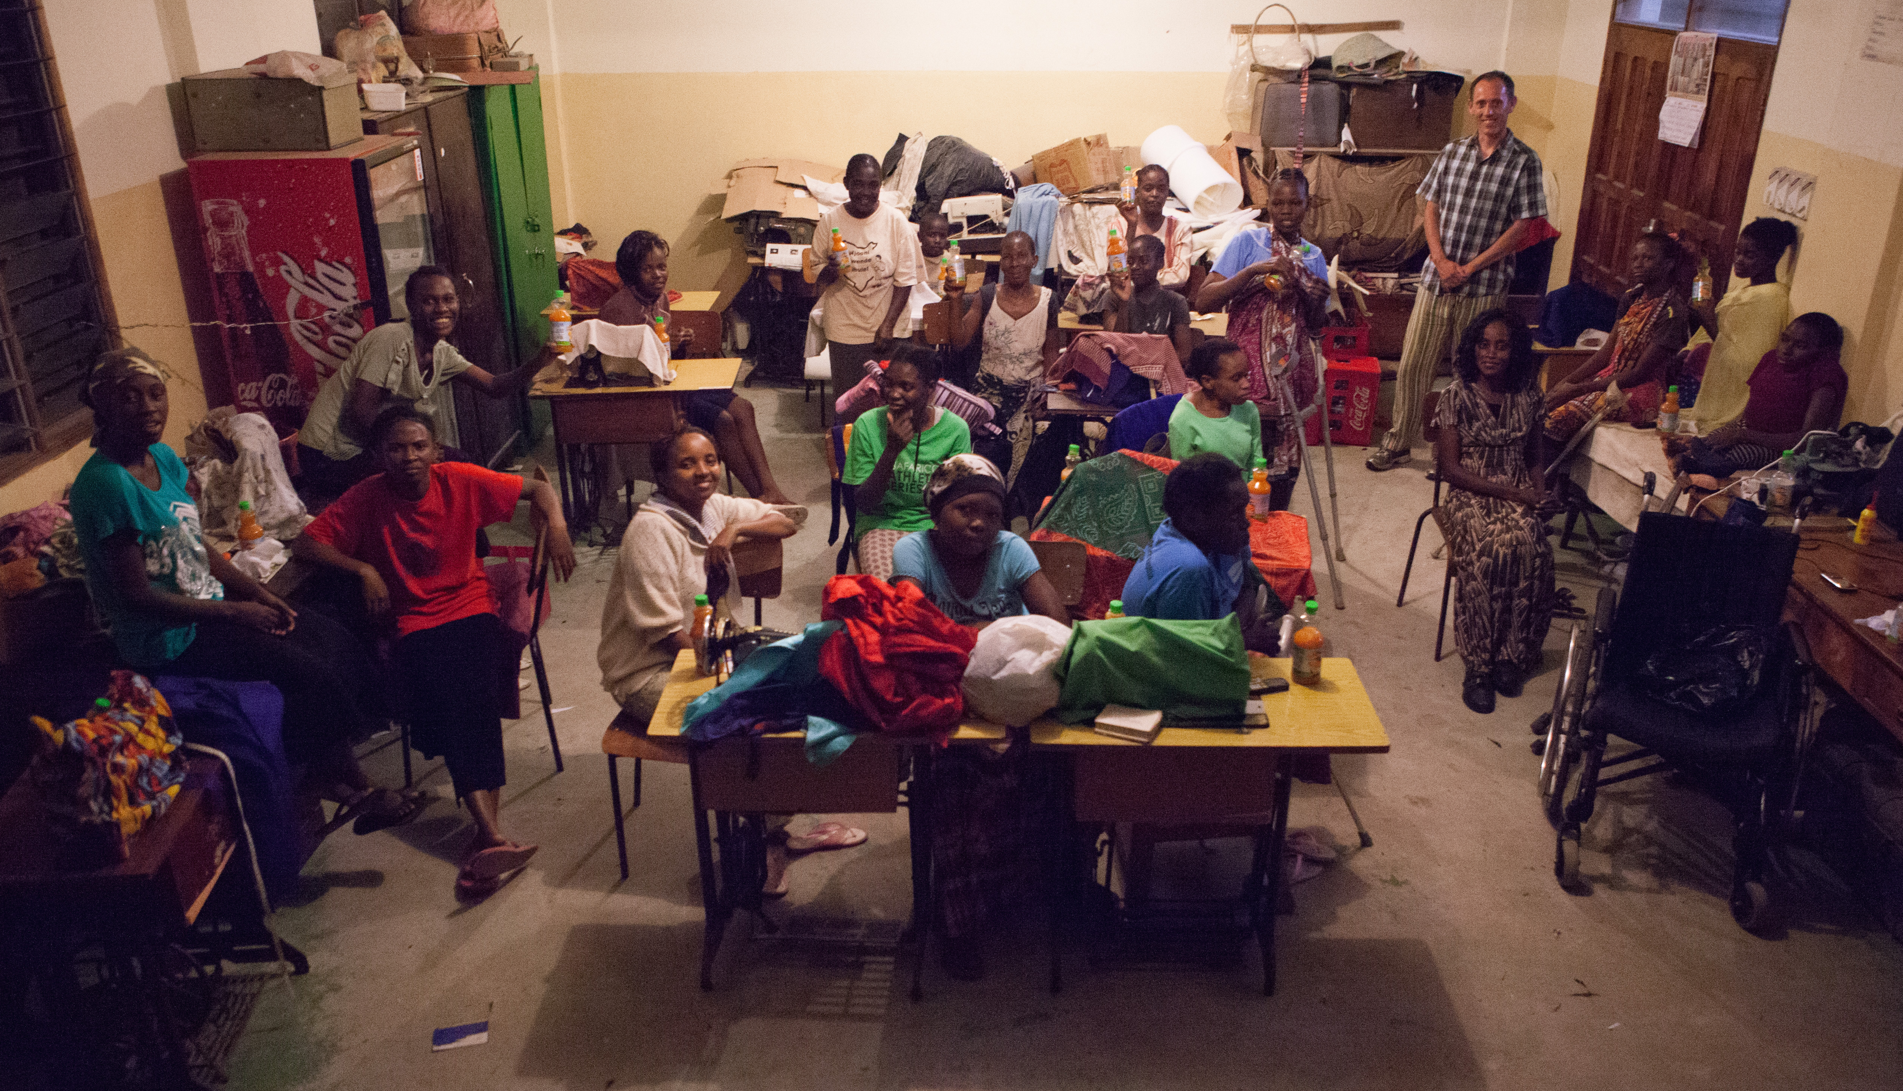
The Shanzu Case – an open online problem based learning platform
Mona Lisa Dahms (mona@plan.aau.dk) & Jette Egelund Holgaard (jette@plan.aau.dk)

Slide 2
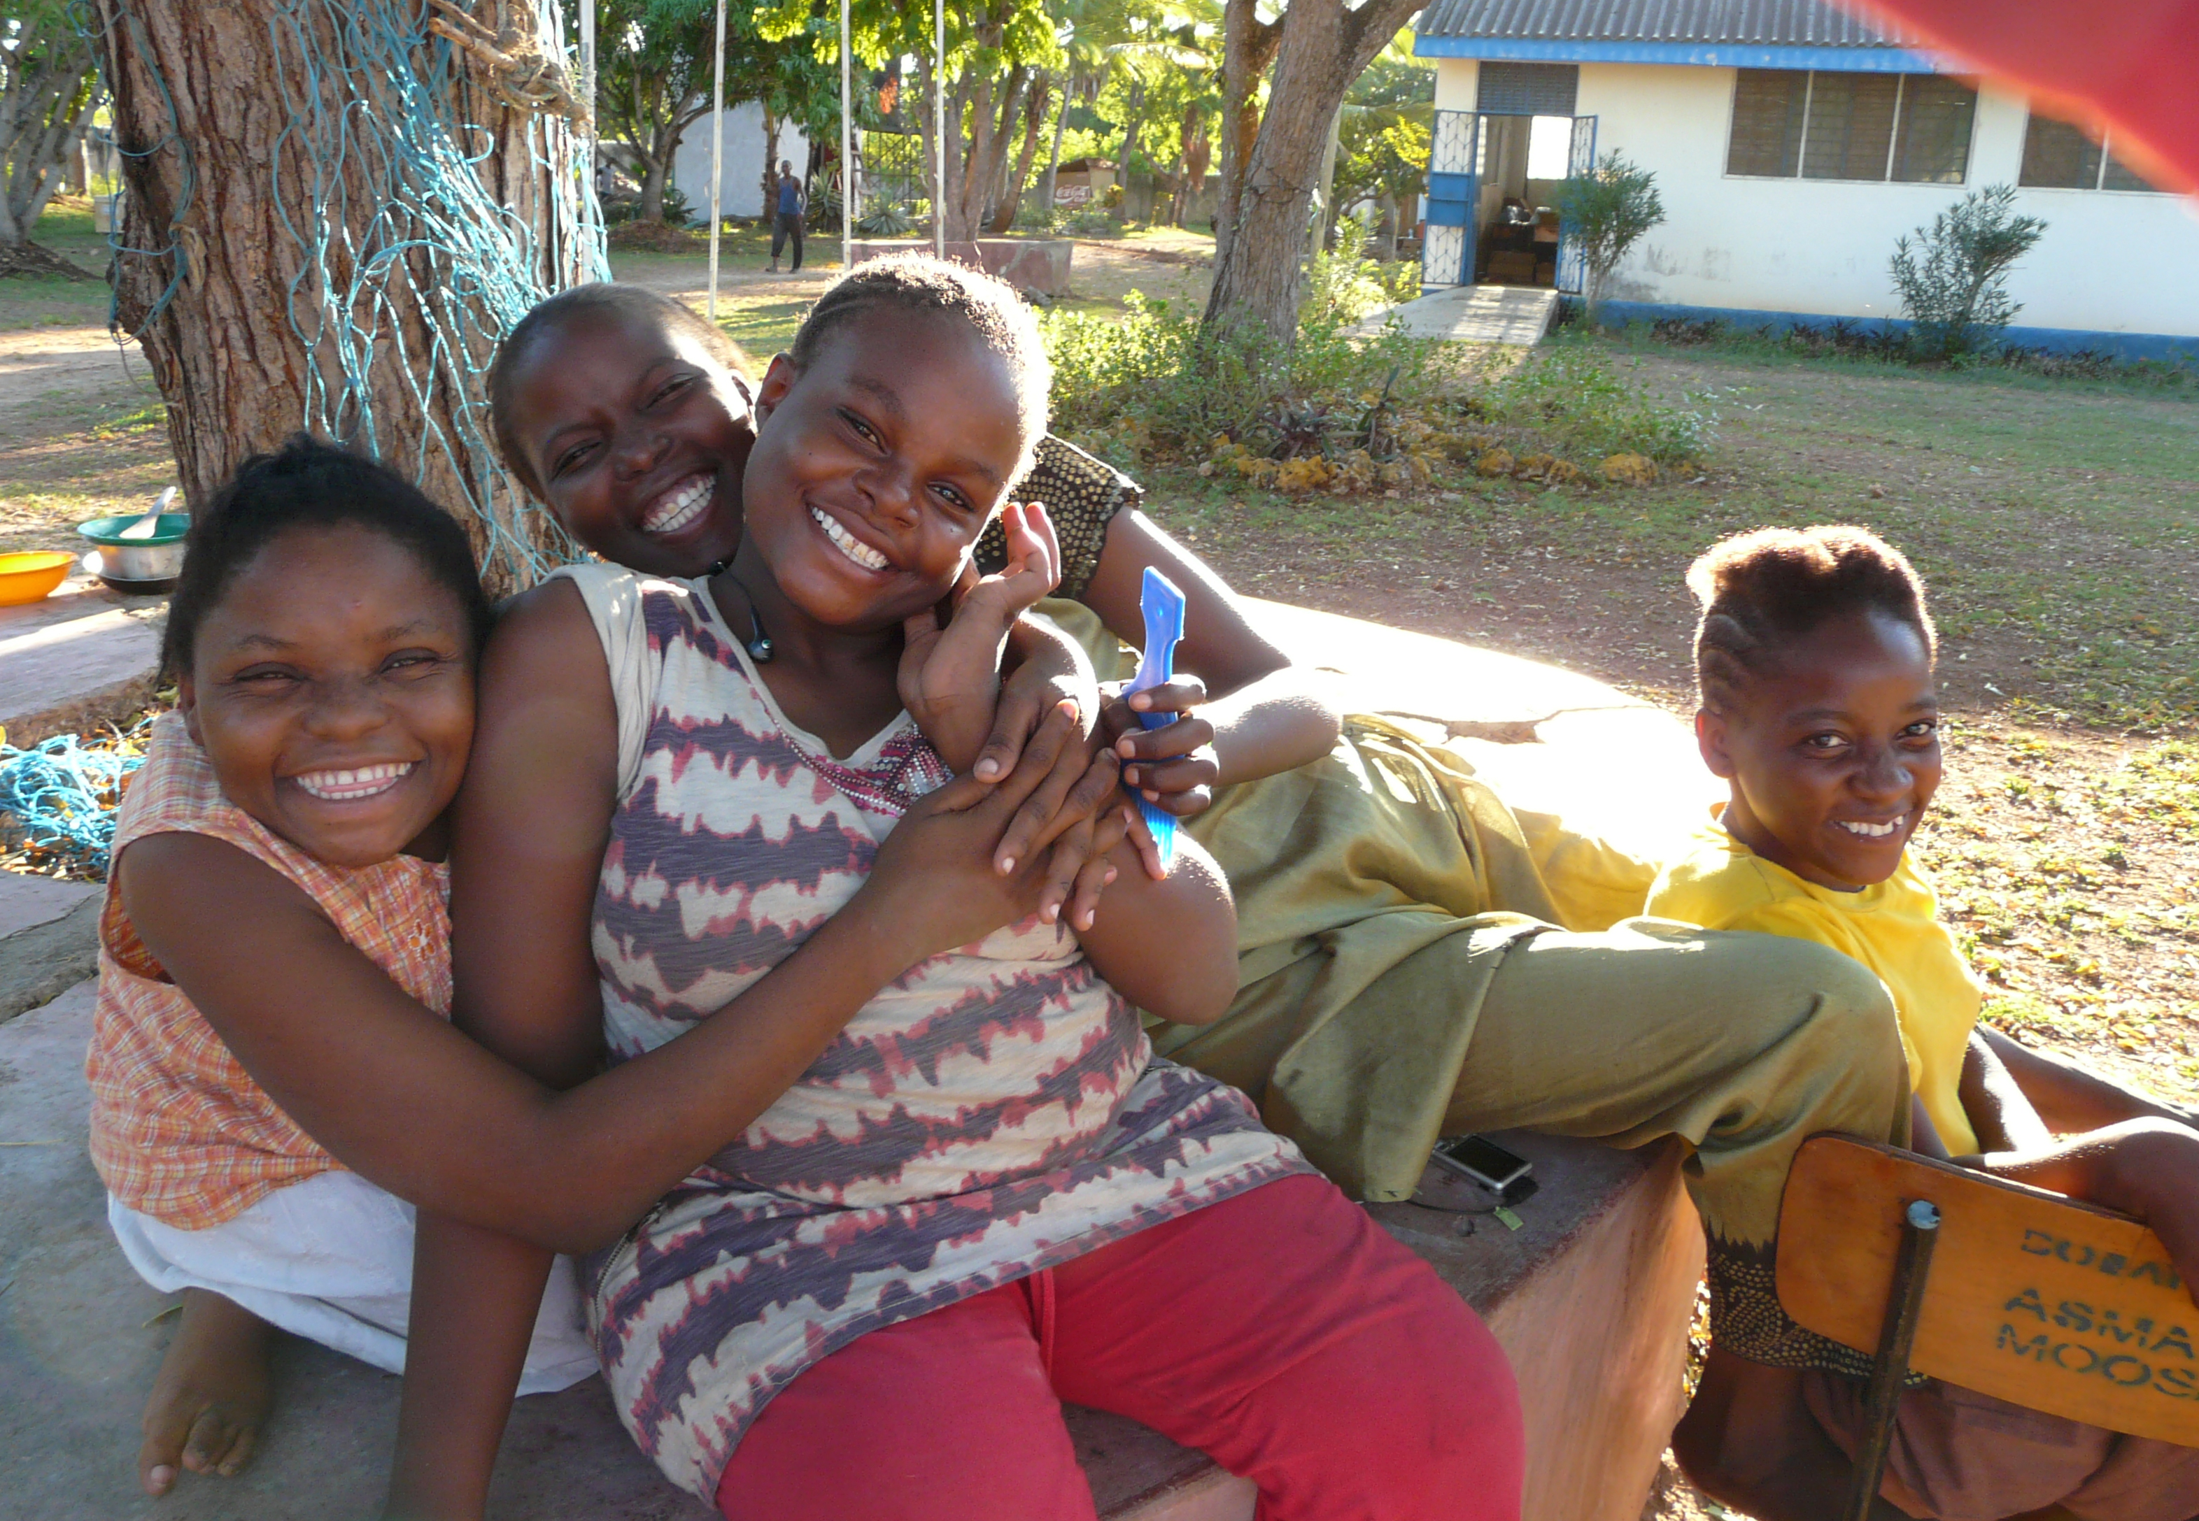
Intended Workshop Outcomes
For participants in the hands-on session the expected outcomes are:
Knowledge about the Shanzu learning material
Inspiration to create problem based online learning material.

Slide 3
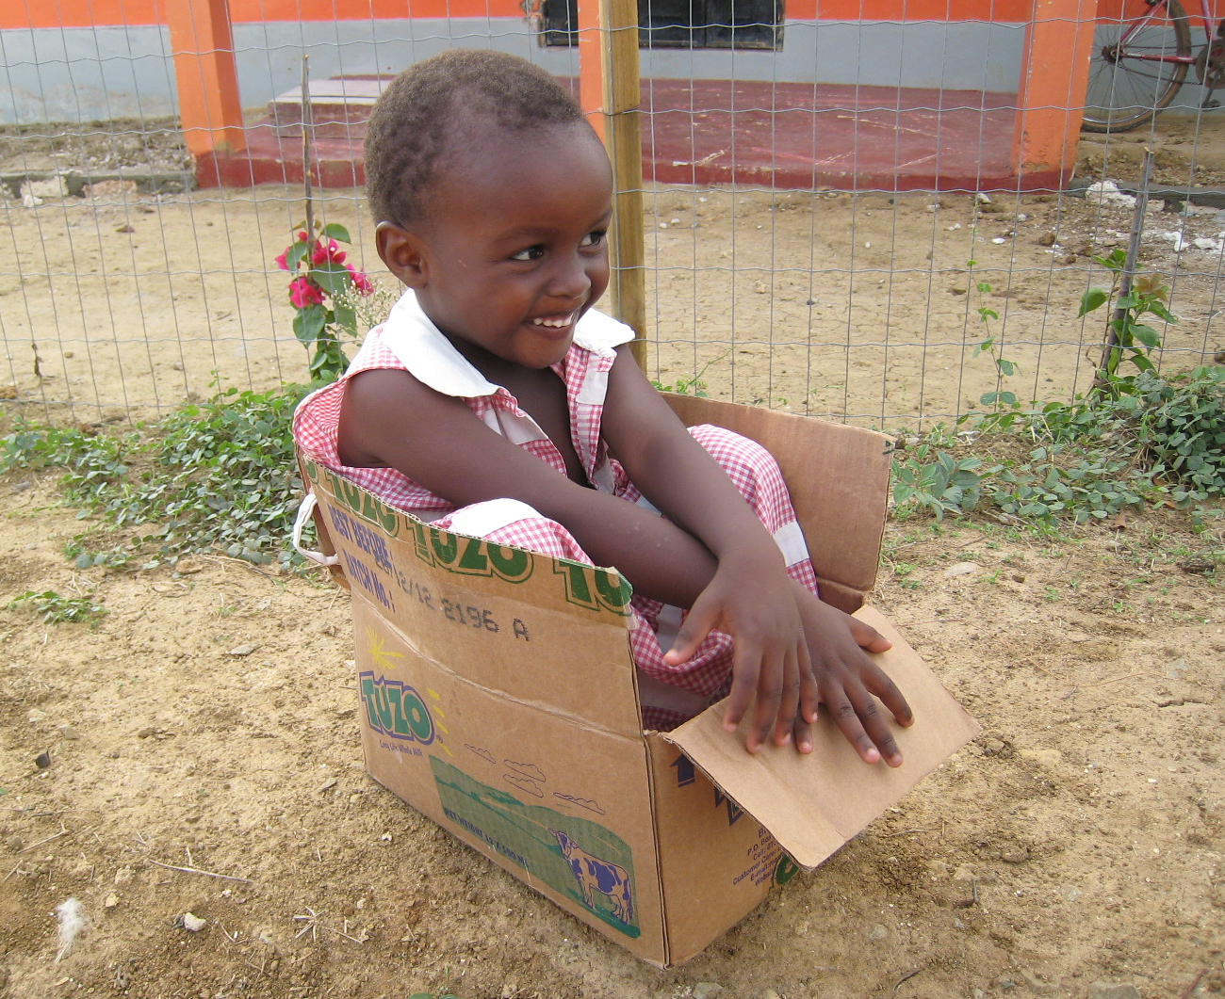
Solutions are like boxes – made with a purpose – used whenever appropriate
© UCPBL
Notes:
Vi starter med en slide fra undervisningsmaterialet, da pointen er at teknologiske systemer skal designes med inddragelse af brugerne i deres kontekst – og der skal følges op under implementering og drift. Brugerne bruger jo ikke altid de produkter som ingeniøren udvikler, som det var intentionen – især hvis vi kommer ind i andre kulturelle sammenhænge. Et eksempel var også at lågene til at afdække vandtankene blev afmonteret – de var nemlig gode til at tørre fisk på ☺

Slide 4
The vision
To develop a problem based e-learning platform that challenges the students in the following areas:
Intercultural collaboration –working with a problem in a cultural context different from their own.
Problem design – identifying, analysing and formulating problems in the given context with focus on the target group.
Technology assessment – assessing potential technological solutions drawing upon knowledge about the given context.
Risk analysis – analysing the associated risks related to a certain technological solution.
Project evaluation – evaluating both product and process related to a technological project.
The means to fulfil the vision is the Shanzu project.
Notes:
Interkulturelt samarbejde – og for de fleste – få mulighed for at arbejde med et problem, der .
Problem design – vi skal ikke have ingeniører, der kun kan reagere på problemer – ingeniøren skal også kunne identificere problemer, analysere dem i den sammenhæng som de indgår i og formulere problemerne, så det er klart hvilke krav der stilles til en problemløsningen.
Foretage en risiko analyse af potentielle løsninger med omtanke for den kontekst i hvilken teknologien indgår.
Lave en risikoanalyse af den teknologi, som
Arbejde som et team mod et fælles mål

Slide 5
Case design
Three central points of departure:
CONTEXT: Problems need to be understood in the context in which they exist –> a contextual learning platform as a supplement to a more traditional academic learning platform.
EXEMPLARITY: A specific case from real life with real actors as participants forms the learning platform – but with focus on methodology, reflection and generalisation.
TEAM WORK: The work with the specific case is project organised and students work and reflect in project teams.
CONTEXTUAL KNOWLEDGE PLATFORM

Slide 6
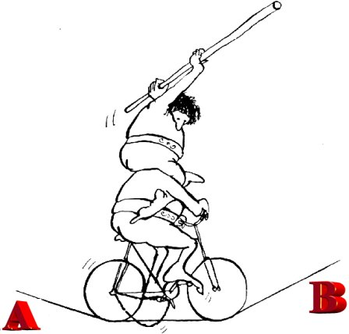
The development process
Four main observations during the process:
ENGAGEMENT: Invaluable input and unbelievable engagement from the original project team.
EXPERIENCE: Being part of the Shanzu learning project team has been an extraordinary experience
CHALLENGE: Processing the enormous amount of data, turning it into short inputs in the form of lectures, short presentation etc. has been a challenge.
ITERATIONS: … lots and lots of iterations in the attempt to turn the data material into a useful learning platform.
Billede: http://projektcoaching.dk/frmain.htm
Notes:
Billedet skal vise Mogens under planlægningen af casen – på cyklen – uden hans historie ville det have været umuligt at få projektet op at stå.
Vi sidder så ovenpå og forsøger at holde balancen…. ;-)
På andre tidspunkter var der så andre der trådte i pedalerne ;-)

Slide 7
The implementation - 1
Eleven meetings with Mogens Meyer, the main actor in the Shanzu project.
Three semi-structured interview guides to project partners, teachers, students, workers and management in the Shanzu workshop.
One field visit to Shanzu Transitional Workshop for Disabled Women July 2015 with Mona Lisa Dahms, AAU, Jesper Hougaard, Grundfos, and Emil Vinther, Vinther Photography as participants. A total of 15 interviews and several recordings of the implemented solution were made.
Two days of recording with Mogens Meyer at AAU. Recording included interviews, presentations and walk-throughs based on prepared instructions.
One interview with Jan Hyttel, Human House, Aarhus recorded.

Slide 8
The implementation - 2
Development of slide material, instructions, presentations and recording of 8 lectures.
Coding many hours of recording into themes used for editing.
Cutting and editing the film material – a total of 36 films, incl. the 8 lectures.
Recording of voice over on 3 films in British English by Andrew Fish, Consultant, Language Centre, AAU.
Development of web-based learning platform and upload of video material.
Development of a guide to teachers about integration of the learning material into a specific teaching context.

Slide 9
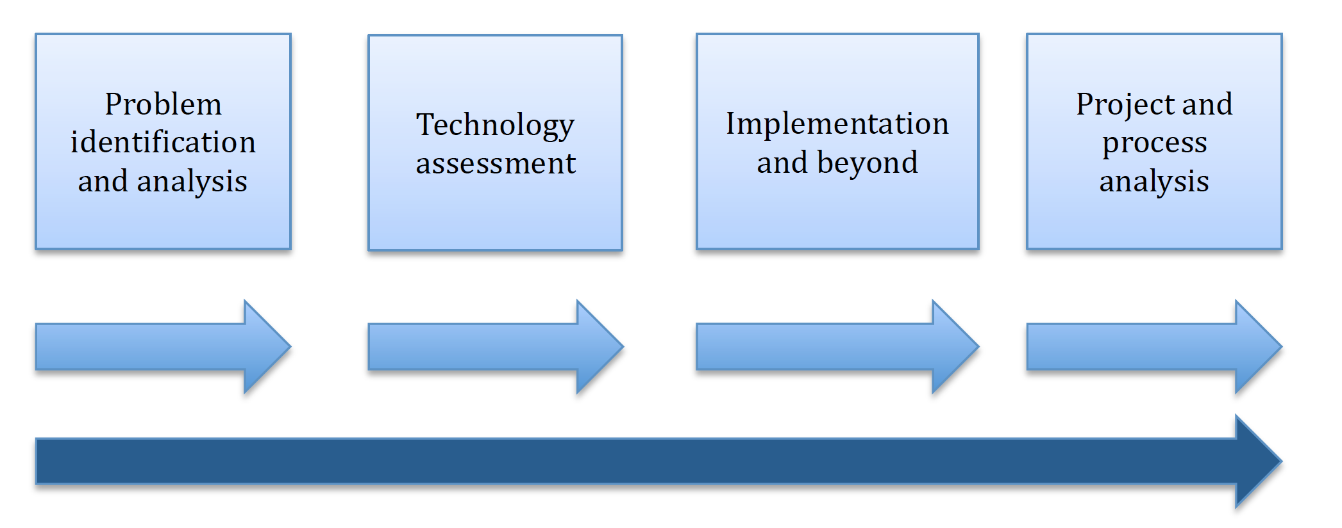
The use of the learning platform

